Slide 1



Northern Virginia Falls Prevention Alliance
SAIL
DATA COLLECTION
TRAINING
Marymount University Falls Prevention
Grant Team 2023-2027
Visit Our Website
novafallsprevention.com

Slide 2
Why we ask for data and what we do with it.
Received a grant from the Department of Health and Human Services to get evidence-based falls prevention programs into the local community
Need to show them that we are spending their money and making a positive difference in the lives of older adults
Need to show the U.S. Congress that they should continue to put money into the budget to support public health initiatives such as falls prevention

Slide 3


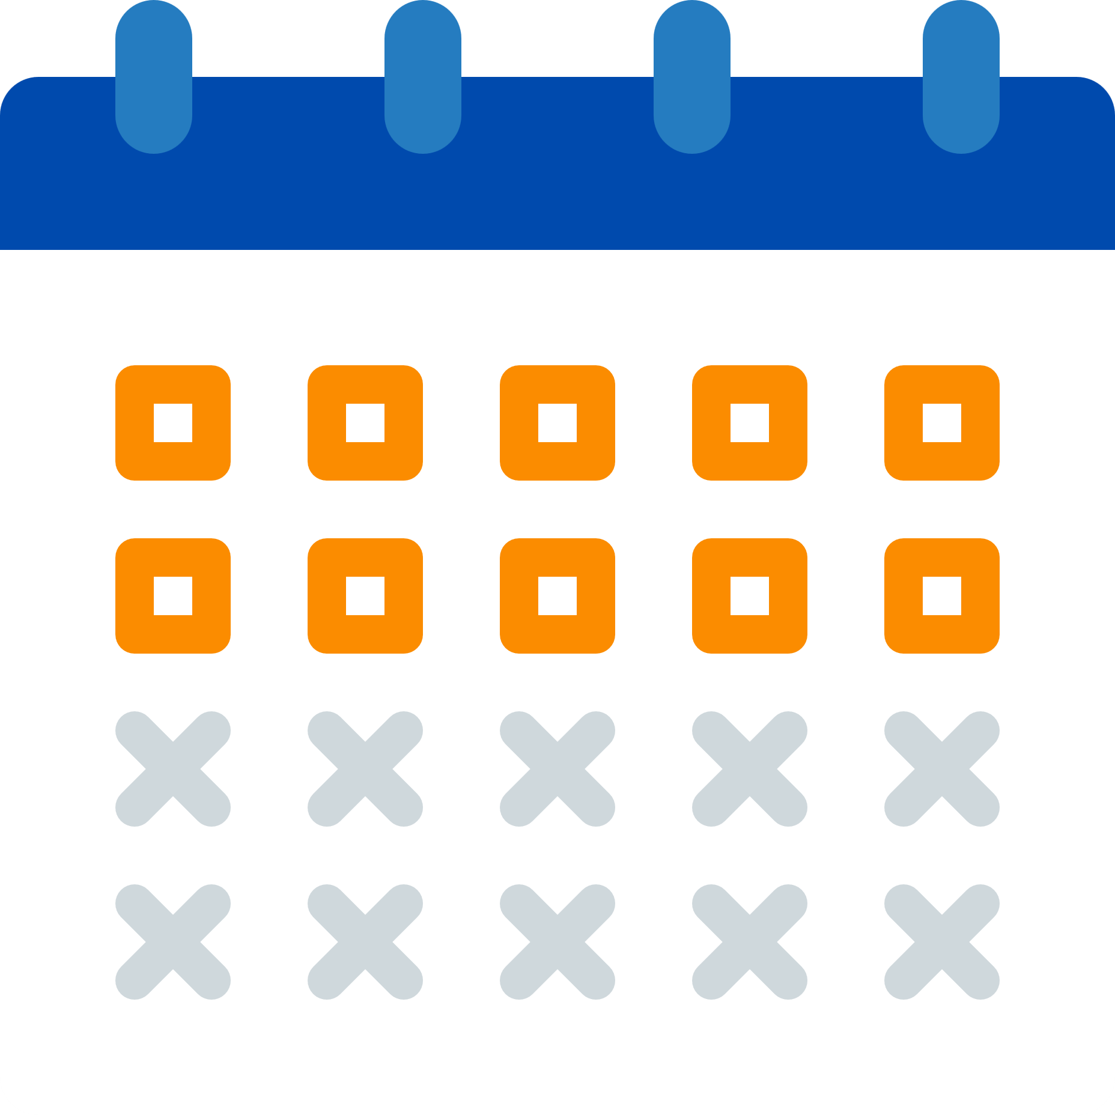
Leader Script
In order for us to be able to collect data, the following script must be read at the beginning of every session.
The script is included in this PowerPoint and can also be found here: https://www.novafallsprevention.com/resource-materials
When should I read the script?
On the day you are having your participants fill out the survey. It could be the day you are doing the fitness checks or the first day of class.
Do I need to read the leader script in its entirety?
Yes, the entire script needs to be read to the class.
What if someone is absent when I read the script to everyone, do I need to read it again?
Yes, it needs to be read prior to having anyone complete the survey.

Slide 4
Falls Prevention Program Group Leader / Coach Script
Read / paraphrase the following points to participants prior to their completion of the Participant Information Form.
  This workshop is made possible by a grant from the U.S. Administration for Community Living (ACL).
  We would like to give you a two-page form today and then at the last class, we will again ask you to complete a brief-post-survey. We would also like to collect the results of your fitness checks which are a part of the SAIL program.
  Before we can share your information with ACL and its database contractor, the National Council on Aging, we want to explain how your information will be used and protected.
  Completing the forms is entirely voluntary. You can skip certain questions or choose not to complete the form at all. If you decide not to complete the form you can still participate in this program.
  However, please know that your information is very valuable to us. We use it to learn who is being reached by this program and to improve our services for others like yourselves. It also helps our funding agencies show that they are spending their money wisely.
  At the top of the form, we assign you a participant number. We will use this information to match against the Attendance Log to track how many times you attend a class and to the post-survey. We will also use this information to match the fitness check results with the pre and post-survey. We do not share your information with anyone else.
  We follow very strict rules to protect all of your information and to keep it private. We will maintain these paper forms securely following standard practices for protecting private data. After a trained person enters your information into a secure online database, we will destroy the paper forms.
  Please take time now to read the form.
  You may ask us to explain any questions that you find confusing.

Slide 5





Data Collection for each site
We would like to collect the following information for every
SAIL session at a site.
*Attendance Sheet
*Fitness Checks
Attendance is collected at every class in a session. See the Attendance sheet Data Collection PPT here.
Pre/post fitness checks are a SAIL requirement. See the Fitness checks Data Collection PPT here.
*Participant Information Form
*Post Survey
Post Surveys are completed at the end of every session. See the Pre and Post Survey Data Collection PPT here.
Participant information forms are completed within the first two weeks. See the Pre and Post Survey Data Collection PPT here.
*Forms can be found here: https://www.novafallsprevention.com/resource-materials

Slide 6

Final Step
I have completed and gathered the following paperwork:
Participant Information Sheet
Fitness Checks
Post Program Survey
Attendance Sheet
What do I do next?
Option 1: Notify the RTO the documents are ready for pick up.
Option 2: Scan in and send as an attachment to rto@marymount.edu.

Slide 7
Thank you!!!

