Slide 1



Northern Virginia Falls Prevention Alliance
SAIL
Attendance Sheet
Data Collection
Marymount University Falls Prevention
Grant Team 2023-2027
Visit Our Website
novafallsprevention.com

Slide 2



Attendance Sheet
https://www.novafallsprevention.com/resource-materials
Do I have to keep attendance?
Yes, for every SAIL class.
Do I have to use the attendance sheet provided?
Your own attendance sheet can be used. Please ensure the participants chronological number is also reflected in the pre and post survey.
If I have a class that runs twice a week, do I submit attendance as two sheets or one sheet?
Please submit attendance as one sheet. For example: Classes held Tuesdays and Thursdays, both days should appear on the same attendance sheet (see sample next few slides.)

Slide 3
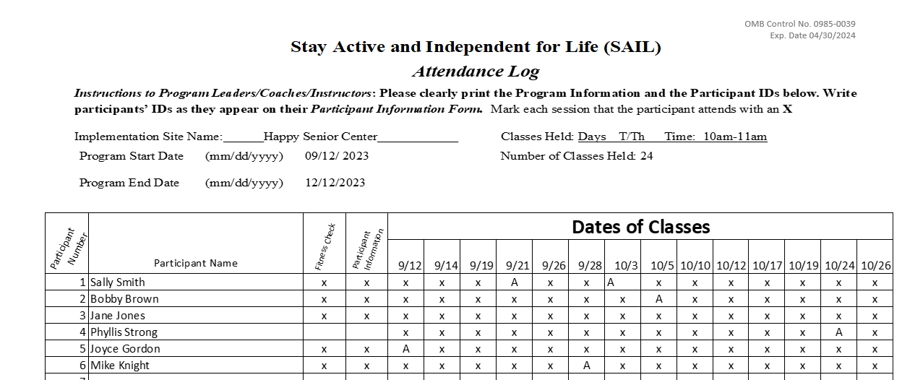
Sample of Completed Attendance Sheet
Attendance sheets can be found here: www.novafallsprevention.com/resource-materials

Slide 4
Attendance sheets can be found here: www.novafallsprevention.com/resource-materials
Participant Number is the new identifier used on the pre and post surveys.
We have created a space to track whether a participant has completed their Fitness Check and Participant Information Survey. You can add a column at the end to track the post fitness check and Post Survey.
Use as many copies of the attendance sheet as needed for each participant to have a line to track attendance. The on-line available forms have a second sheet available.
If a class was cancelled or not held, please black out the column.

Slide 5
Using a Different Attendance Sheet
If you decide to use your own attendance sheet, please be sure it has the pertinent information included before submitting to the RTO. The pertinent information is:
  Site Name
  Dates of session
  Number of sessions (Be sure to black out any dates classes were not held and/or cancelled)
  Days/times
  Participant’s Chronological Number is the new identifier

Slide 6
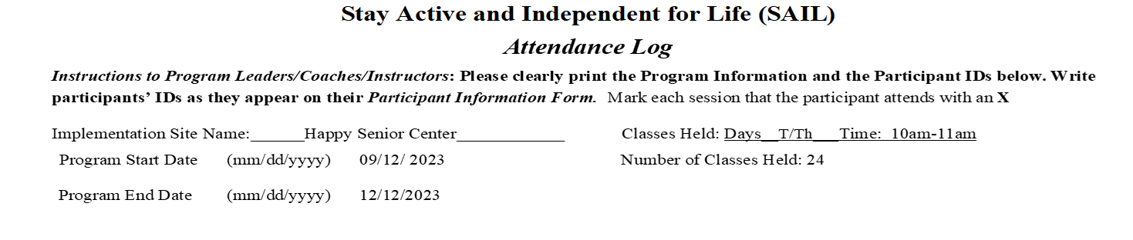
Attendance Sheet Submission
Before submitting the attendance sheet to the rto, black out the names and just have the
identifier visible. This request applies to the surveys and fitness checks also.

