Slide 1



Northern Virginia Falls Prevention Alliance
SAIL
Fitness Checks
Data Collection
Marymount University Falls Prevention
Grant Team 2023-2027
Visit Our Website
novafallsprevention.com

Slide 2



Fitness Checks
https://www.novafallsprevention.com/resource-materials
When are fitness checks conducted?
Fitness checks are conducted within the first two weeks of a session of SAIL classes.
Do I schedule a special day to do fitness checks?
It is suggested that fitness checks be scheduled to be completed before the actual class instruction begins. (This is also a good time to request the participant information survey be completed.)
What if someone does not attend the scheduled day for fitness checks, can I do make-up fitness checks before class? After class?
Yes, make-up fitness checks are allowed for up to the first two weeks of the session start date. It is suggested to conduct fitness checks before class as the participant could be fatigued after the class which would affect their scores.

Slide 3
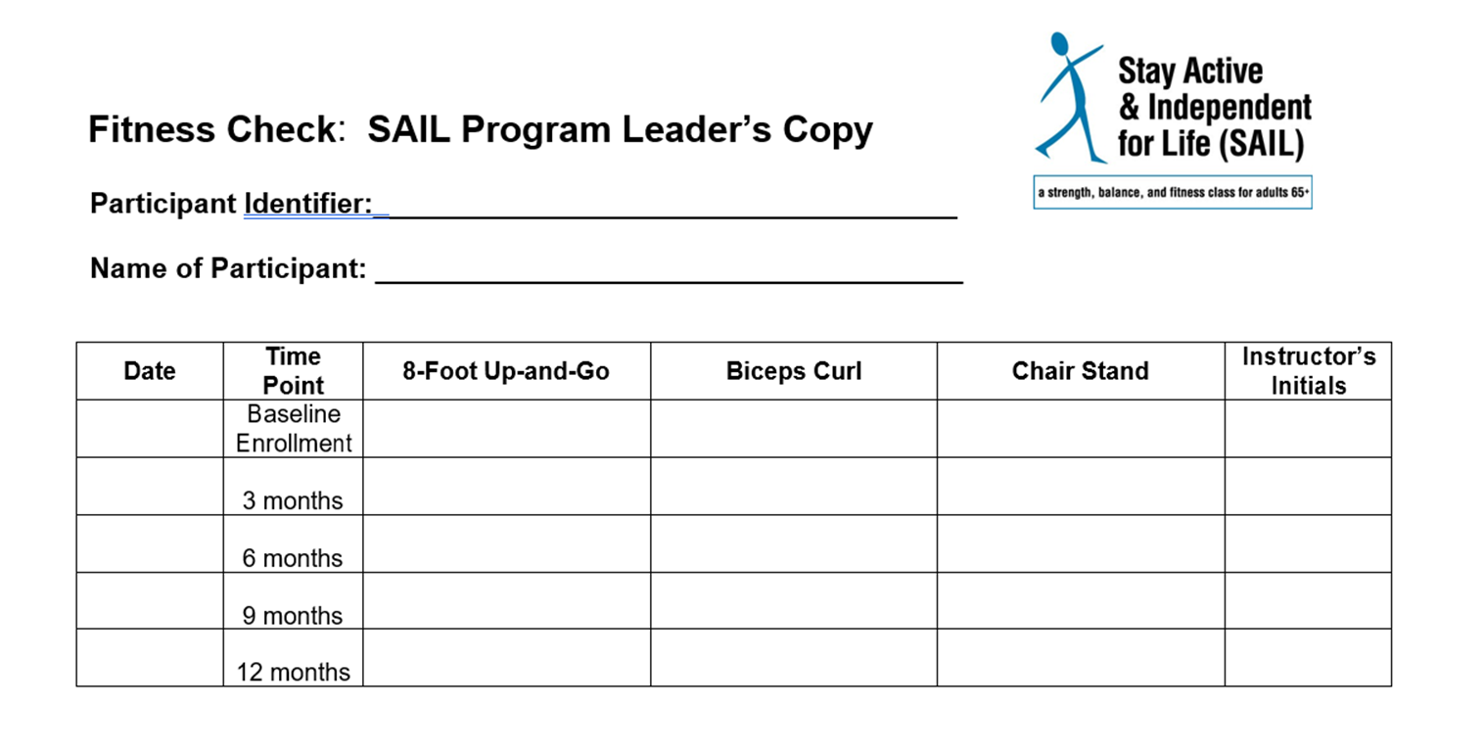
Sample Fitness Check
Chronological number on attendance sheet (1, 2, 3)

Slide 4
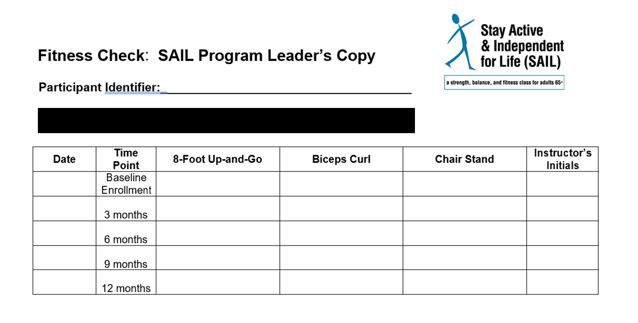
Fitness Check submission
Before you hand the fitness check in, black out the name and just have the chronological number visible on all documents. It should look like this:
Chronological number on attendance sheet (1, 2, 3)

