Slide 1
Northern Virginia Falls Prevention Alliance
Pre and Post Survey
Data Collection
Marymount University Falls Prevention
Grant Team 2023-2027
Visit Our Website
novafallsprevention.com

Slide 2
Participant Information Form
(aka pre-survey)
https://www.novafallsprevention.com/resource-materials
When should this form be filled out by the participant or by the participant with assistance?
Ideal is for this form to be filled out during fitness checks or the first two weeks of the session.
When should this form be turned in to the RTO?
This form is kept safe until the session has concluded and turned in with all session paperwork.
What if a form is only partially filled out, do I still provide it to the RTO?
Yes.
What if a person fills out the form but only attends one class of the session, do I still provide it to the RTO?
Yes. Even if a person only attends once, send in the data.

Slide 3
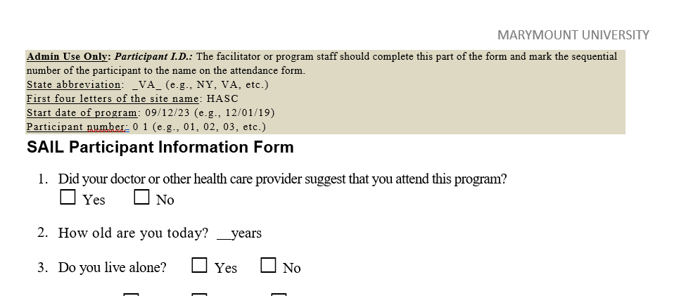
Sample Participant Information Form (aka pre-survey)
Please note: We no longer use the first two letters of first and last name and last two of birth year as the participant identifier. Please discard all old forms.
The participant’s chronological number on the attendance sheet is their participant identifier.
Please be sure the circled information is complete.

Slide 4
Post Program Survey
https://www.novafallsprevention.com/resource-materials
When is the post program survey to be completed?
The post program survey is to be completed by each participant at the end of each session.
Can I make the post program survey available before the end of a session?
It is suggested to make it available for completion the last week of classes for that session.
Am I allowed to review the surveys handed in to me?
All information on the surveys are confidential. Upon getting the completed survey from the participant, please put it in a folder that can be provided to the RTO.

Slide 5
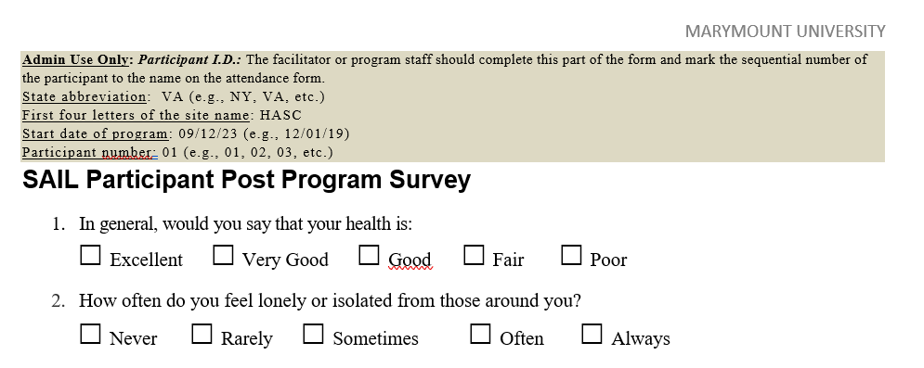
Sample Post Survey
Please note: We no longer use the first two letters of first and last name and last two of birth year as the participant identifier. Please discard all old forms.
The participant’s chronological number on the attendance sheet is their participant identifier.
Please be sure the circled information is complete.

